Slide 1
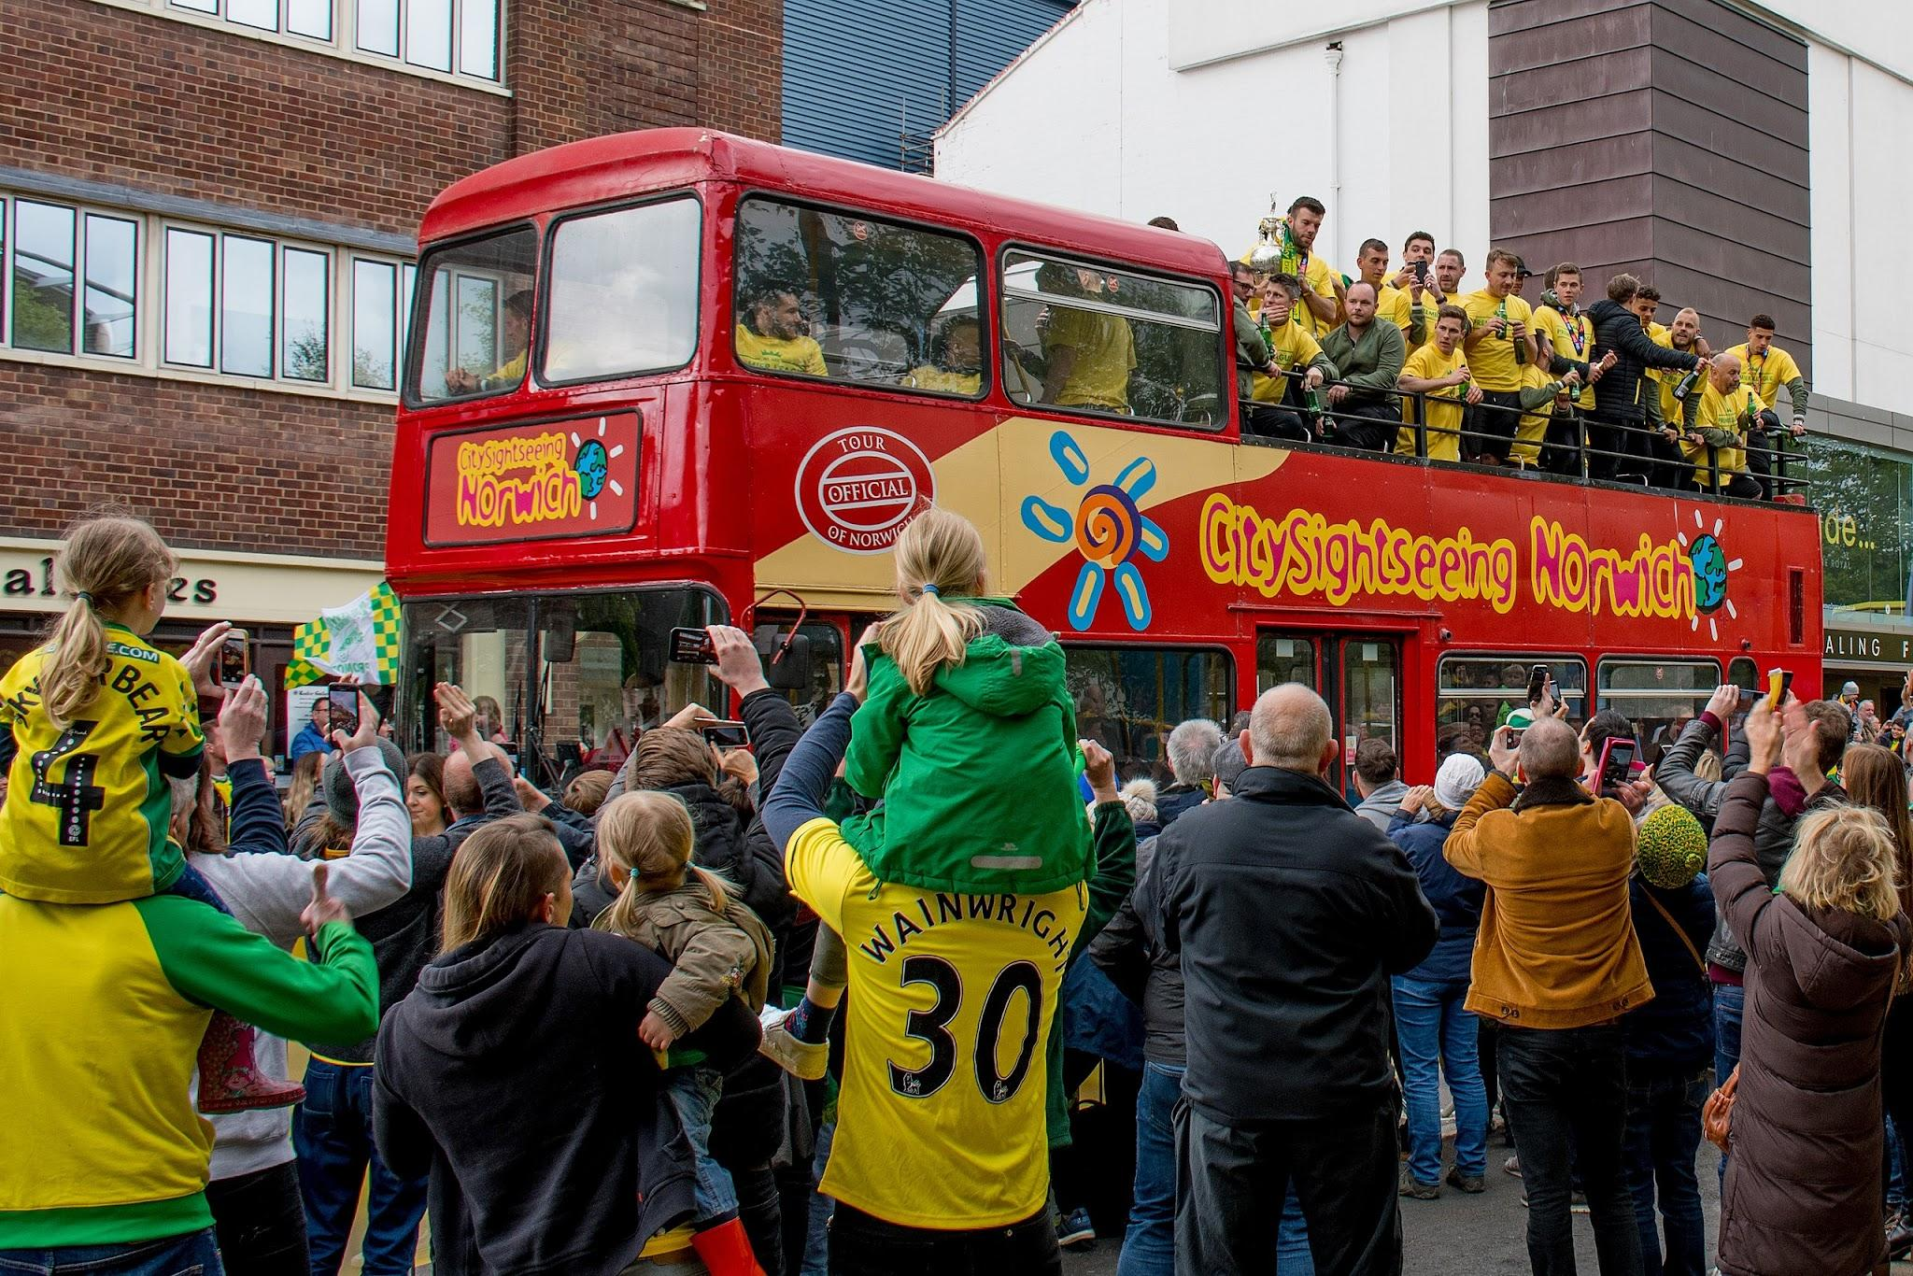
10 Facts about Norfolk
By Thomas

Slide 2
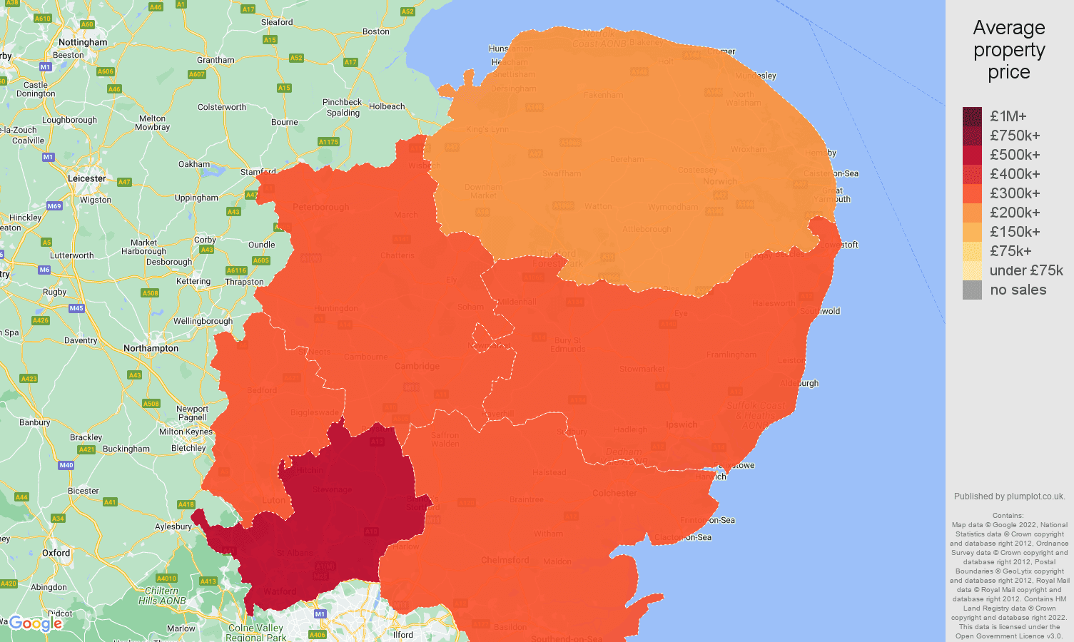
Location
Norfolk is the northernmost county of East Anglia. A region settled by a German Tribe called the Angles. Norfolk comes from “North Folk”

Slide 3
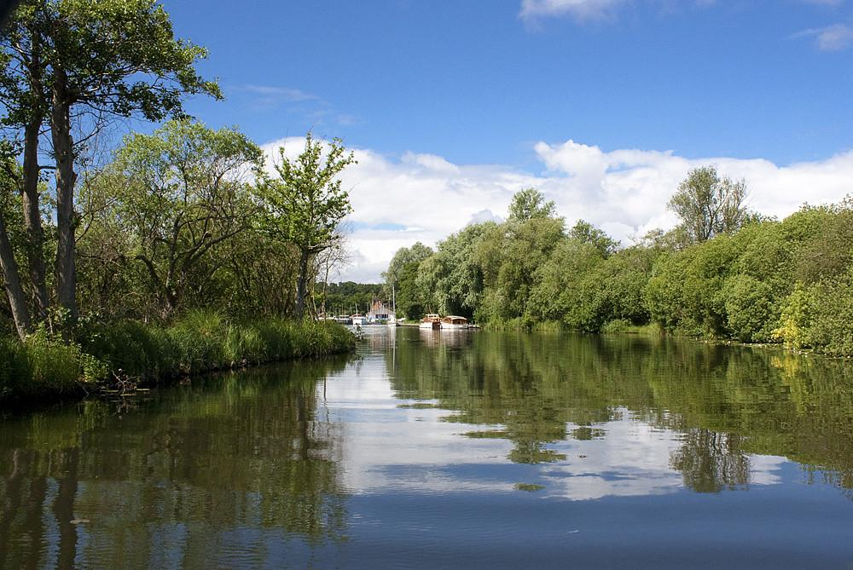
Broads National Park
Unique to Norfolk is the Broads National Park, home to over a quarter of the rarest plants and animals in the UK and is Britain's largest protected wetland.

Slide 4
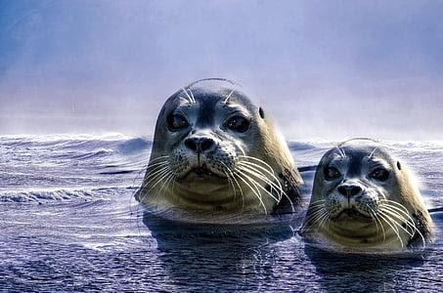
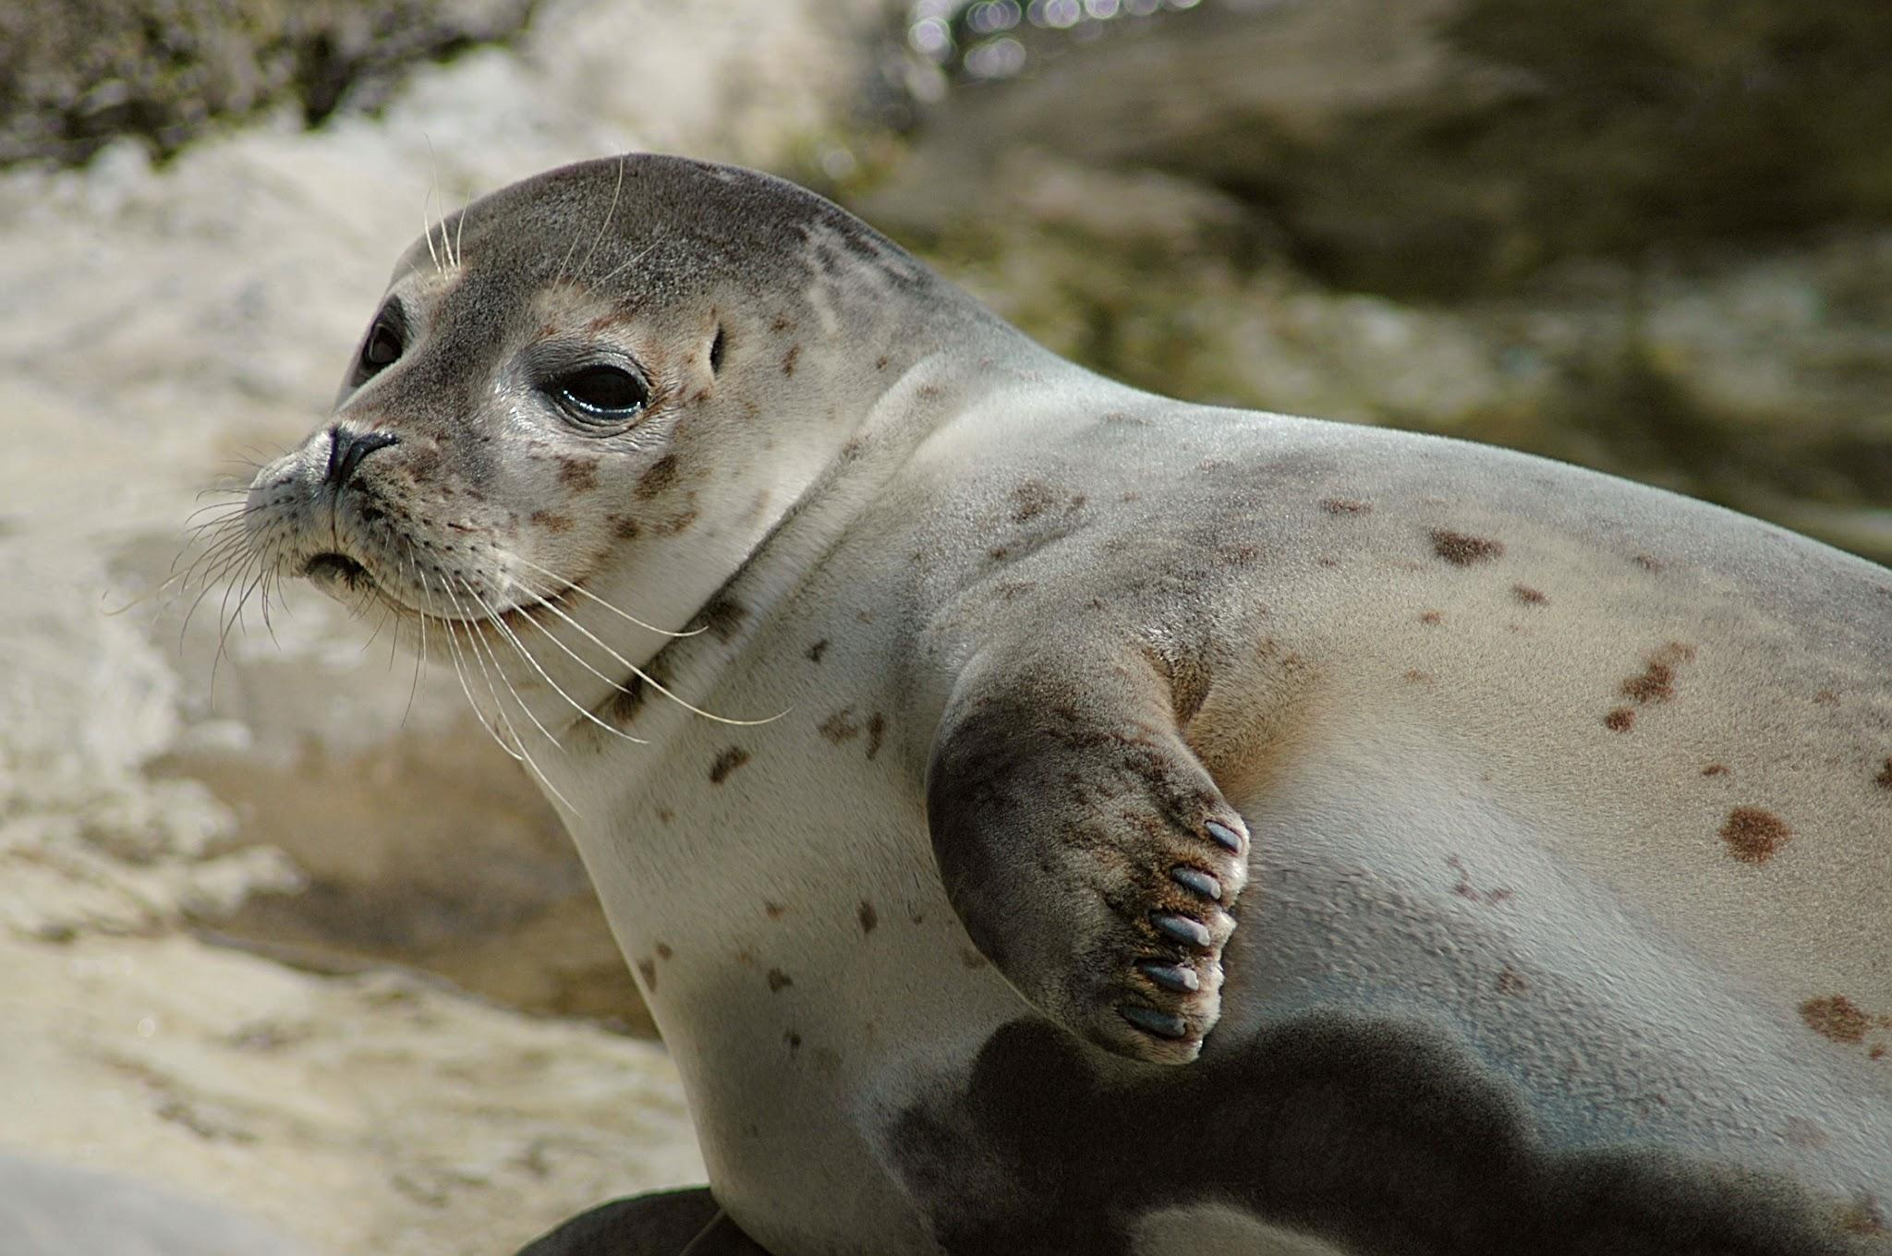
Seals
Blakeney Point is home to Common and Grey seals and is one of the biggest colonies in winter in England, with around 2500 pups.

Slide 5
Flag
The Flag of Norfolk dates back to the first Earl of Norfolk, who became Earl in 1069 under William the Conqueror.

Slide 6
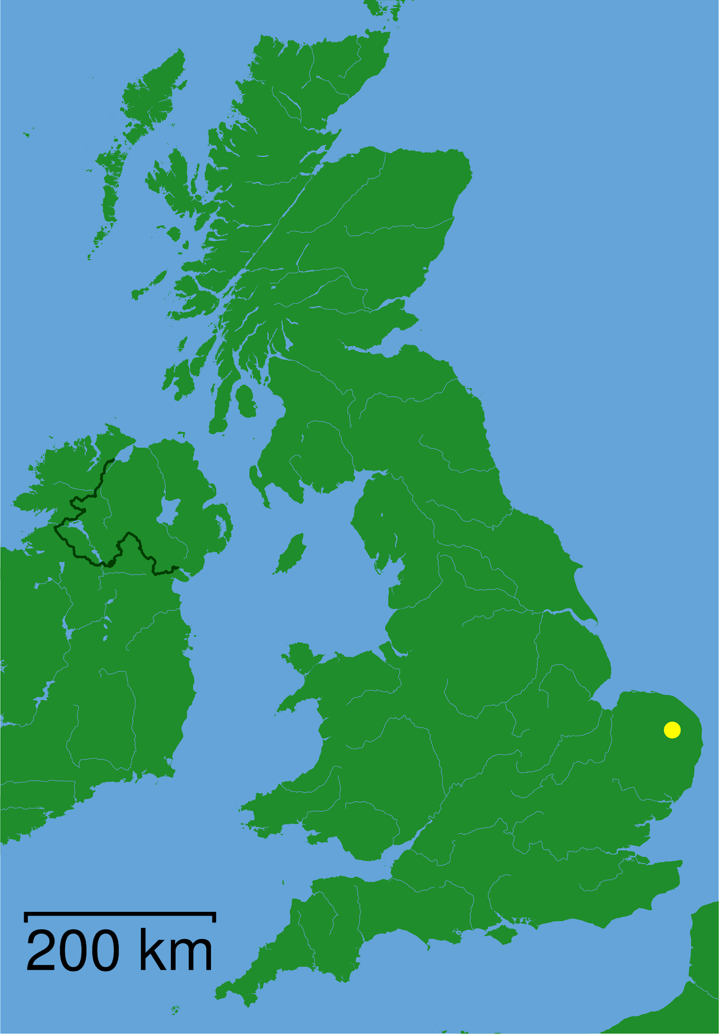
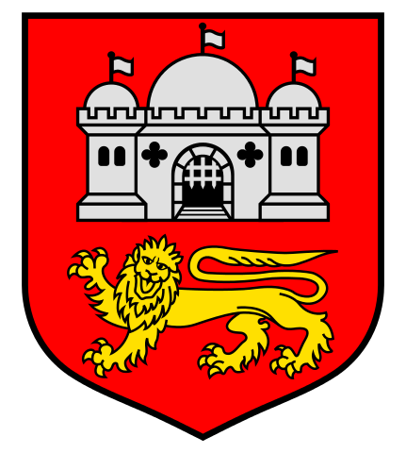
Capital
The Capital city of Norfolk is Norwich

Slide 7
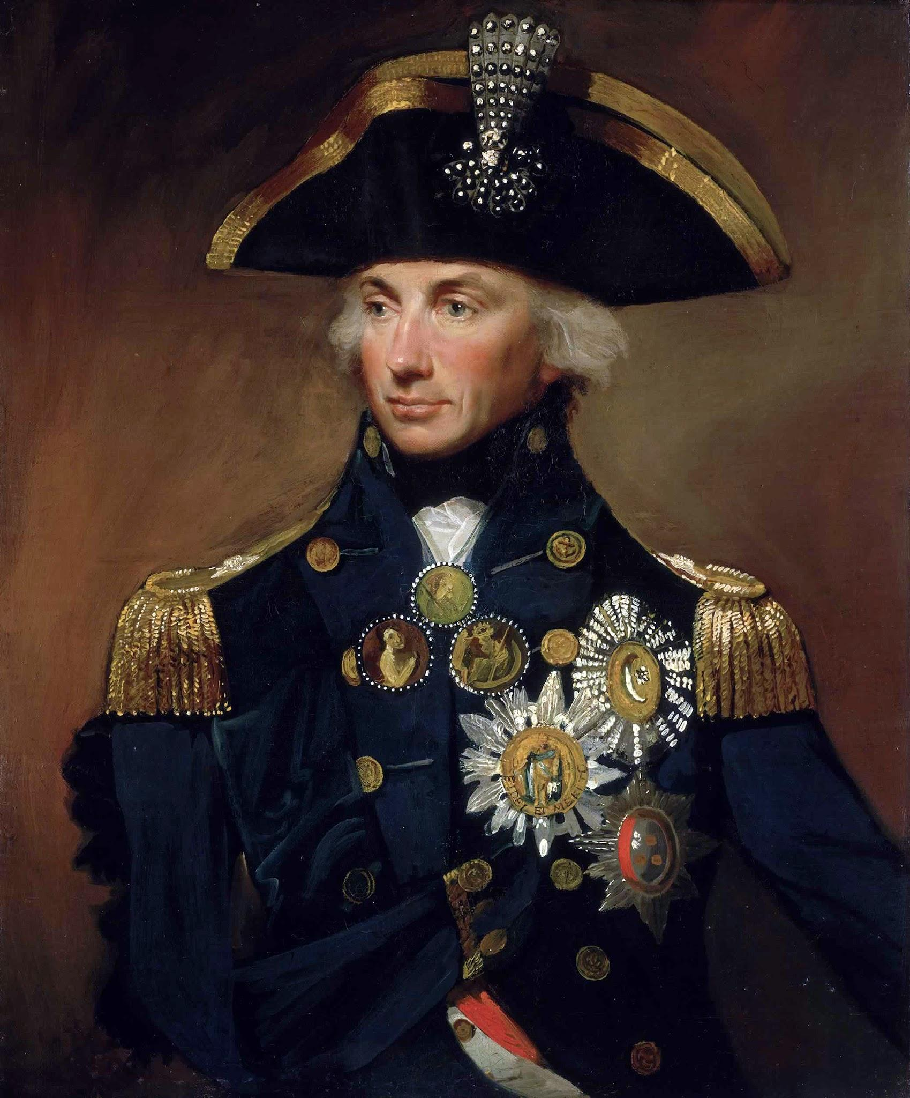
Famous Person
It was in Norfolk that Vice-Admiral Horatio Nelson, 1st Viscount Nelson Horatio Nelson was born (29 September 1758 – 21 October 1805), went to school and learned to sail which lead to him becoming the country’s greatest naval hero. Winning the Battle of Trafalgar against the French Navy.

Slide 8
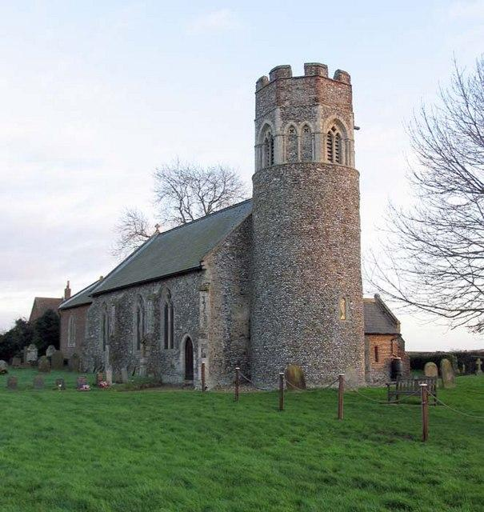
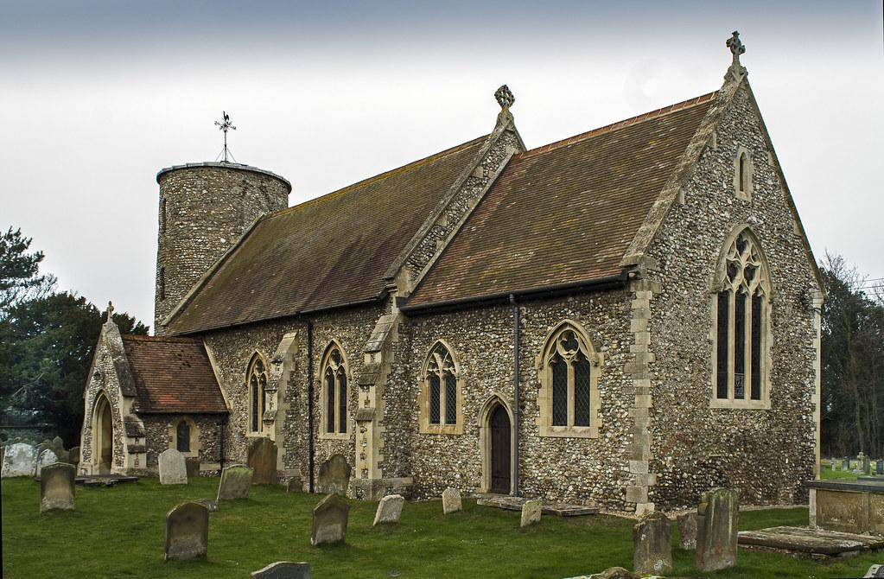
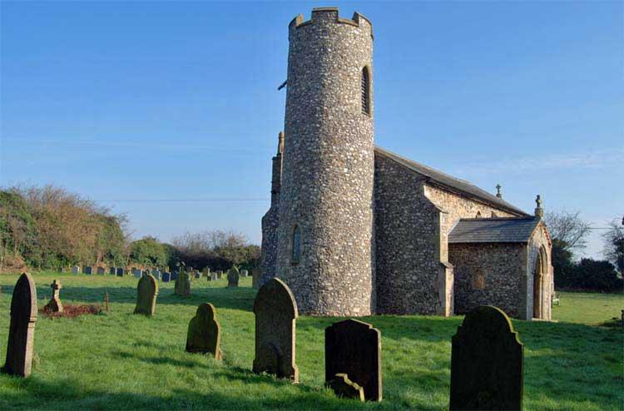
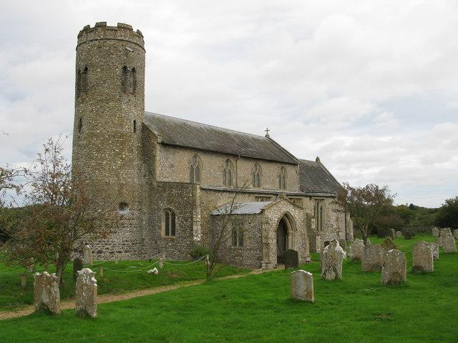
Churches
Round Tower Churches. Norfolk has 120 round tower churches, more than three times the number than any other county. Built in the 100 years after 1050

Slide 9
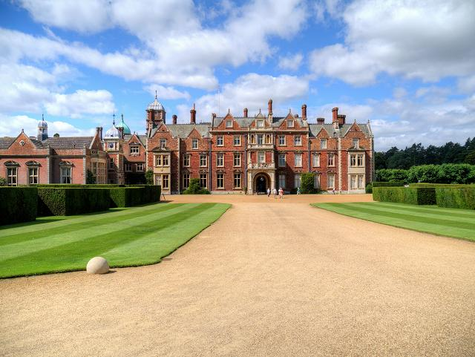
The Royals
The British Royal family have a country estate in Sandringham, which they use for their summer holidays.

Slide 10
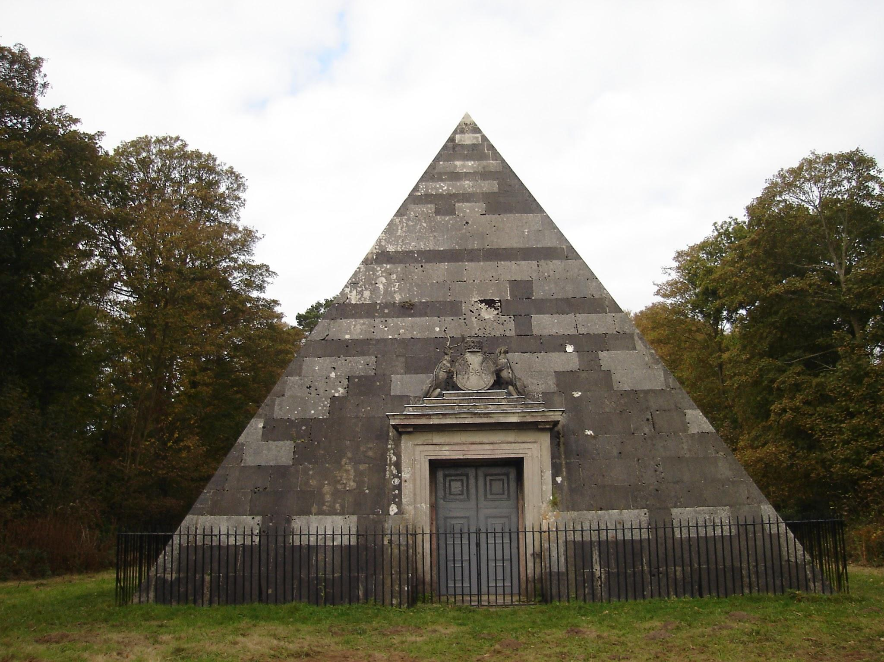
The Blickling Pyramid
It’s quite unusual to find a pyramid in Norfolk, but you can find one here!
Built as a resting place, in 1794 for the 2nd Earl of Buckinghamshire, the pyramid can be seen in the Great Wood at the Blickling Estate,

Slide 11
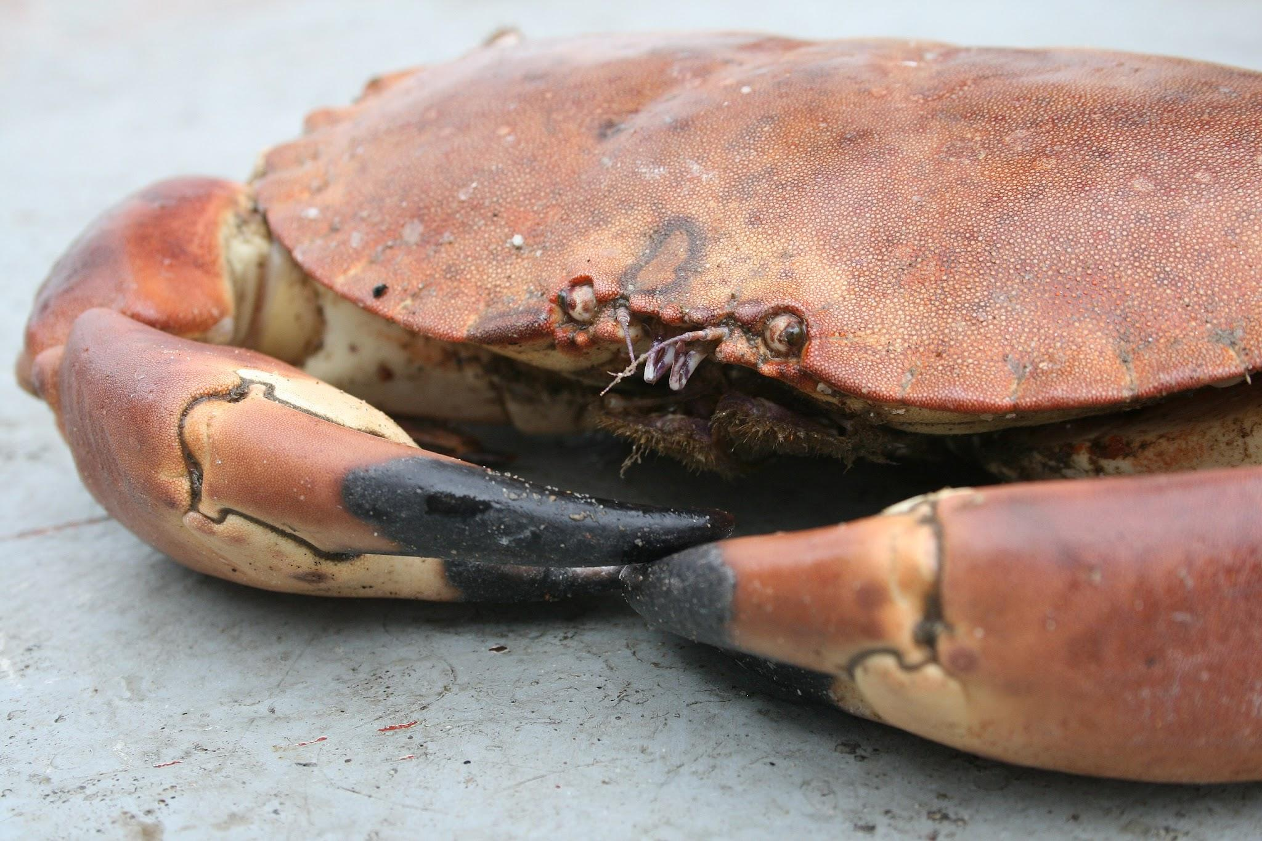
Cromer
Cromer is a seaside town in North Norfolk. It is famous for its crabs.

Slide 12
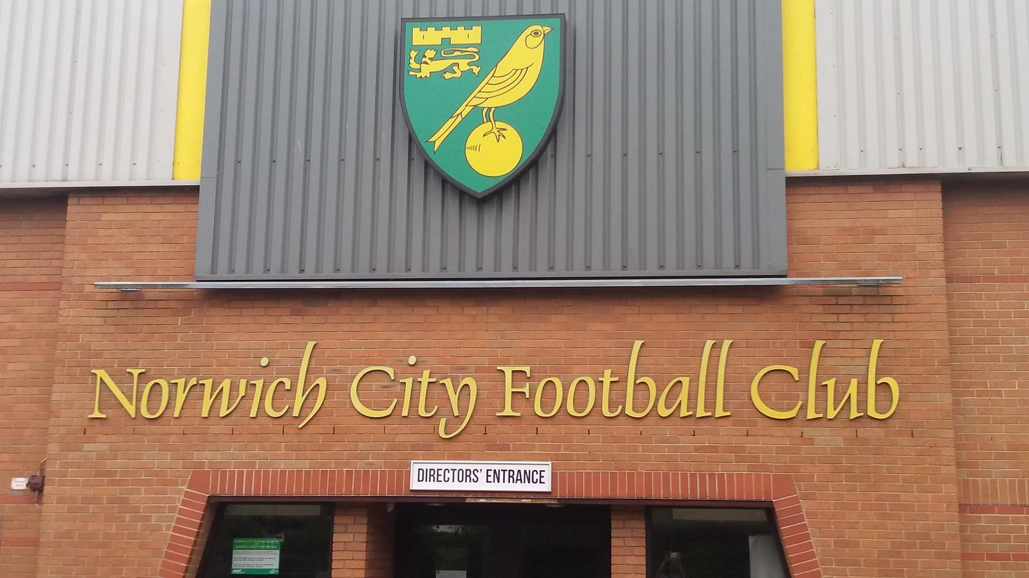
Thank You
The End

