Slide 1
NORFOLK QUIZ
How much do you know about where you live?

Slide 2
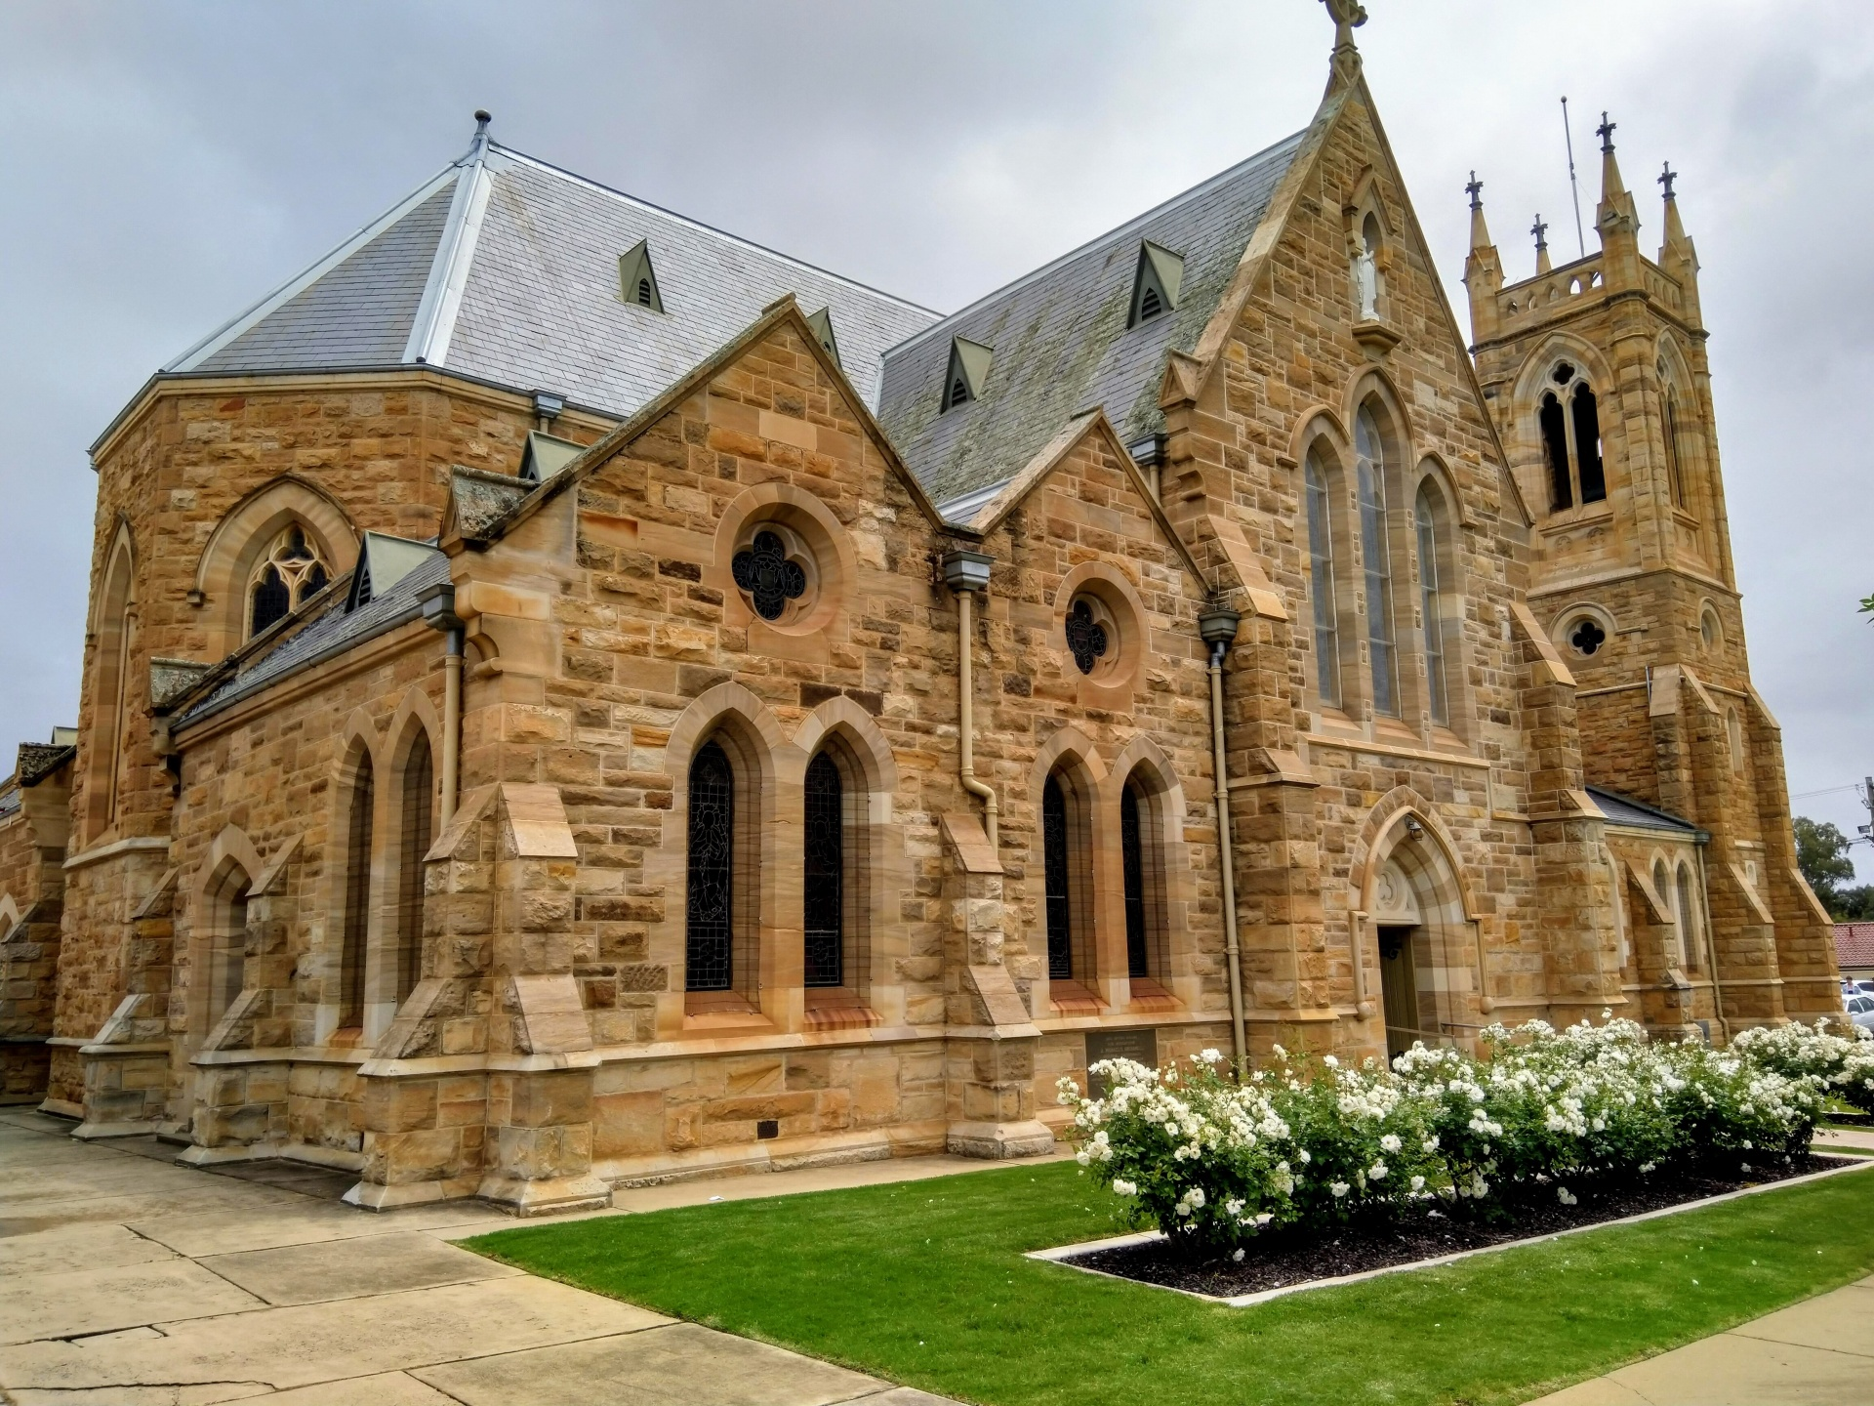
How many medieval churches are there in Norfolk?
A) 100
B) 400
C) over 650

Slide 3
How many medieval churches are there in Norfolk?
A) 100
B) 400
C) over 650

Slide 4
When was the Norman fortress Castle Rising built?
A) 1140
B) 1240
C) 1340

Slide 5
When was the Norman fortress Castle Rising built?
A) 1140
B) 1240
C) 1340

Slide 6
Thetford Forest covers an area of around
A) 50 square miles
B) 80 square miles
C) 100 square miles

Slide 7
Thetford Forest covers an area of around
A) 50 square miles
B) 80 square miles
C) 100 square miles

Slide 8
What is a Bishy Barnabee?
A) ladybird
B) beetle
C) worm

Slide 9
What is a Bishy Barnabee?
A) ladybird
B) beetle
C) worm

Slide 10
How long is Norfolk’s coastline?
A) 100 miles long
B) 60 miles long
C) 80 miles long

Slide 11
How long is Norfolk’s coastline?
A) 100 miles long
B) 60 miles long
C) 80 miles long

Slide 12
How high is the spire of Norwich Cathedral?
800 ft
315 ft
100 ft

Slide 13
How high is the spire of Norwich Cathedral?
800 ft
315 ft
100 ft

Slide 14
Fill in the missing word.
Norfolk is England’s _________ largest county
Third
Fourth
Fifth

Slide 15
Fill in the missing word.
Norfolk is England’s _________ largest county
Third
Fourth
Fifth

Slide 16
Old Catton was inhabited as far back as the _______ age?
A) stone
B) iron
C) bronze

Slide 17
Old Catton was inhabited as far back as the _______ age?
A) stone
B) iron
C) bronze

Slide 18
Cromer’s best known feature is its _______ built in 1900.
Lighthouse
Pier
Church

Slide 19
Cromer’s best known feature is its _______ built in 1900.
Lighthouse
Pier
Church

Slide 20
People from Norfolk are sometimes known as .
A) Norfolk dumplings
B) Norfolk puddings
C) Norfolk meatballs

Slide 21
People from Norfolk are sometimes known as .
A) Norfolk dumplings
B) Norfolk puddings
C) Norfolk meatballs

Slide 22
Thank You
Isabella
+44 1239 876 554
kalle@email.com
www.fabrikam.com

